Slide 1
Snake and Ladder Board Game
Team 04 - ISTE 121
Chen, Jiajia
Chen, Shuying
Lin, Fei

Slide 2
Overview
This project is an online board game for single or multiple users, the game is snake and ladder.
Contains three screen: SERVER, CLIENT, and GAME
SERVER: shows all the message that sending back and forward between the server and clients.
CLIENT: It show chat GUI first, for the connection to server. After user connected to the server, and server start the game, it will pop up the a new screen for game.
GAME: screen that playing the snake and ladder, with the image of the board game and the players.

Slide 3
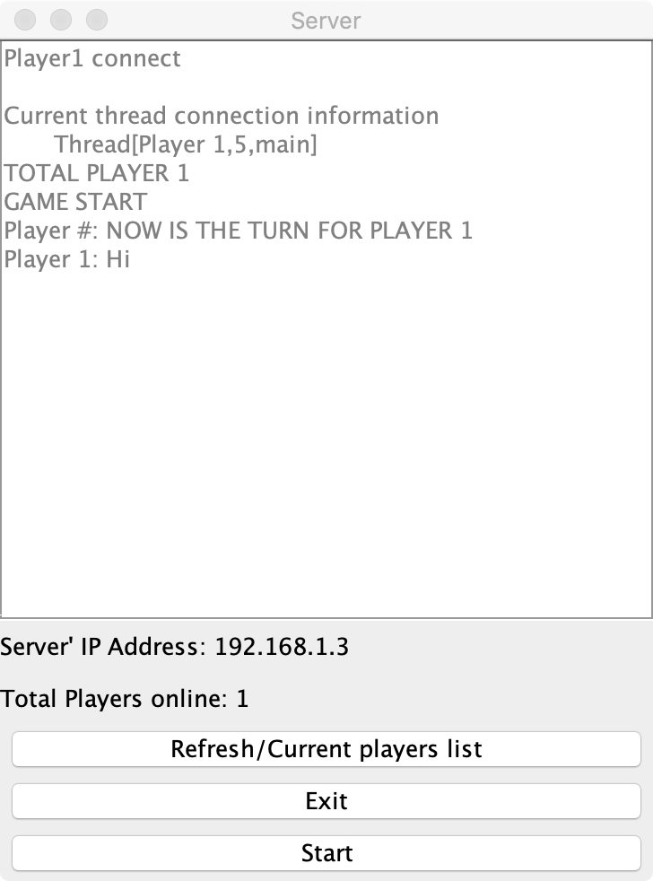
GUI for Server
Server’ IP Address:
display server’s ip address, allow clients to enter the address to get connect
Total Players online:
Display total numbers of current active clients
Button - Refresh/Current players list:
Display a list of current clients
Button - Exit:
Closed the program
Button - Start:
Start the game

Slide 4
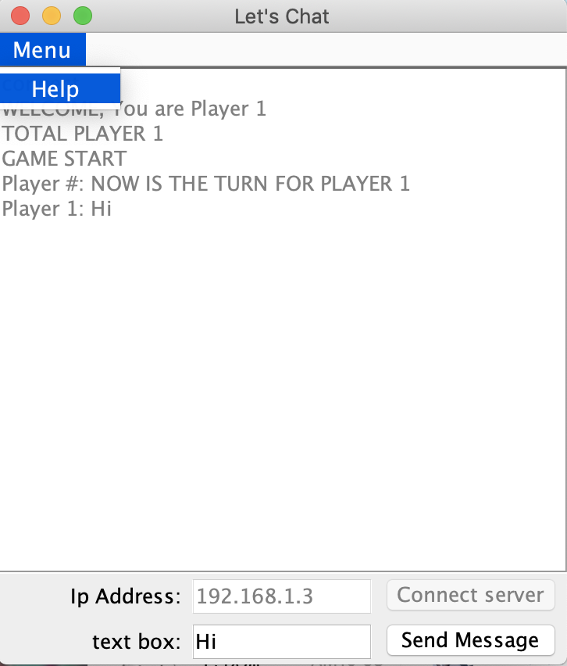
GUI for Client
Button - Connect server:
Allow user to type in server’ ip address and connect to server
Button - Send Message:
Allow clients to type the words and sent to all the players
MENU Button - Help:
Will displays a dialog that describe the application, and rule of the game

Slide 5
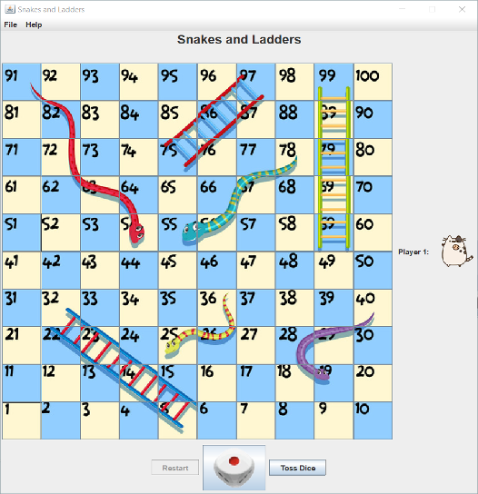
Game Board
Button - Toss Dice :
Randomly generate a number from 1 to 6, the number represent the steps that play can move
Button - Restart:
After declare the winner, players can click RESTART to play again
Menu - File - Exit:
Button for exit the program
Menu - Help - About:
Display game rule

Slide 6
Purpose and target audience
The purpose of this application is to allow our audience to learn the basic sequence and pattern of numbers. They will consistently be rolling dice and counting the numbers on the board.
Our target audience can be people at any age and gender.
For the younger user, from age 3 to 8, they can learn some basic computer such as clicking the mouse, typing the text, counting, and knowledge of playing basic board games.
For the older user, from age 60 to 80, it will be a great game to have some exercise for their hands, eyes, and counting in mind.
This game is approved for all, everyone who is getting bored, or want to relax they can play this game.

Slide 7
HOW TO PLAY
When the game starts, the user or users will need to toss a die, the number of the die will determine the number of steps that they can move.
For example, if a user rolls a 4, then the user would move their piece four places. The user will move their pieces from left to right, starting at 1, following the numbers on the board.
The first user that reaches the highest space on the board, which is 100, wins the game.
When a player lands on a top of a snake, their playing piece will slide down to the bottom of the snake.
When a player lands at the base of a ladder, it immediately climbs to the top of the ladder.
the winner needs to roll the exact number to reach 100.
If players roll the number that is over 100, they stay in the same space where they roll the dice.

Slide 8
Unresolved Issues
We have a problem about the replacement image of the player move. If there is more than one player in the same position. Not sure how to appear both of them are in the same position because one player image will replace another player image.
The maximum numbers of total players are limited to six, because we only contains six players images. If the numbers of total players are exceed six, they can have a chat, but not able to playing the game with more than six people.

Slide 9
Reference - data used
Image: https://www.vectorstock.com/royalty-free-vector/snakes-and-ladder-game-template-vector-23813393
Sample of Snake and Ladder java code: https://rosettacode.org/wiki/Snake_And_Ladder#Java
Dice images will be found online.
https://image.baidu.com/search/detail?ct=503316480&z=0&ipn=d&word=筛子%201到6&step_word=&hs=0&pn=2&spn=0&di=17930&pi=0&rn=1&tn=baiduimagedetail&is=0%2C0&istype=0&ie=utf-8&oe=utf-8&in=&cl=2&lm=-1&st=undefined&cs=4060570382%2C451230636&os=1234429836%2C3104516760&simid=3509062187%2C720304968&adpicid=0&lpn=0&ln=1260&fr=&fmq=1587502126523_R&fm=&ic=undefined&s=undefined&hd=undefined&latest=undefined&copyright=undefined&se=&sme=&tab=0&width=undefined&height=undefined&face=undefined&ist=&jit=&cg=&bdtype=0&oriquery=&objurl=http%3A%2F%2Fkfwimg.ikafan.com%2Fupload%2F83%2Fcc%2F83cc289953ec99b79986ea9346e7abc4.png&fromurl=ippr_z2C%24qAzdH3FAzdH3Fooo_z%26e3Bhwuwg_z%26e3BvgAzdH3Fj17AzdH3Fcd88abcm_z%26e3Bip4s&gsm=3&rpstart=0&rpnum=0&islist=&querylist=&force=undefined
Players images:
https://www.pinterest.com/pin/408772103672738093/?nic_v1=1aRtLeQeT3VmAIg9%2Fph0c5DBHEiKr2G5xRWNej3BJNYgey8TNF4cLEb0bZKp%2BdAg1w

